Slide 1
NFL consumer marketing insights
Joshua Kong – Data Scientist
Date: Today

Slide 2
STOP WORDS
Not all-inclusive
Team names
Player names
Coach names
Jargon too specific to a class
Features that were not statistically significant

Slide 3
MODEL ACCURACY SCORES
Logistic Regression
Train: 92%, Test: 88%
Random Forest
Train: 85%, Test: 81%

Slide 4
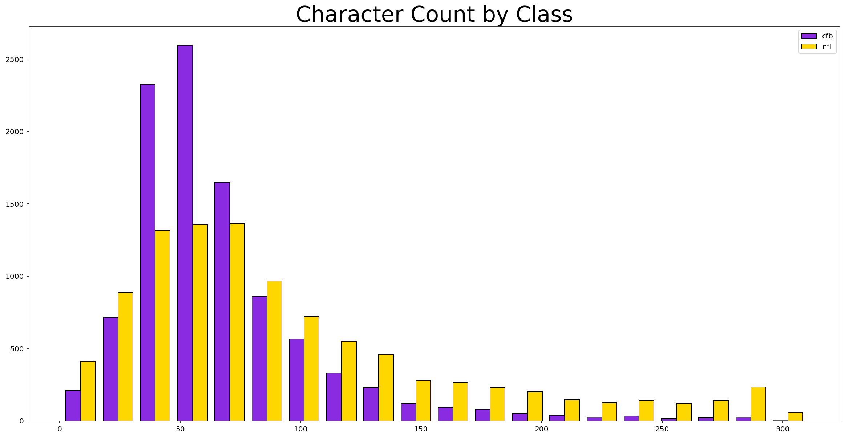
SOPHISTICATED AUDIENCE

Slide 5
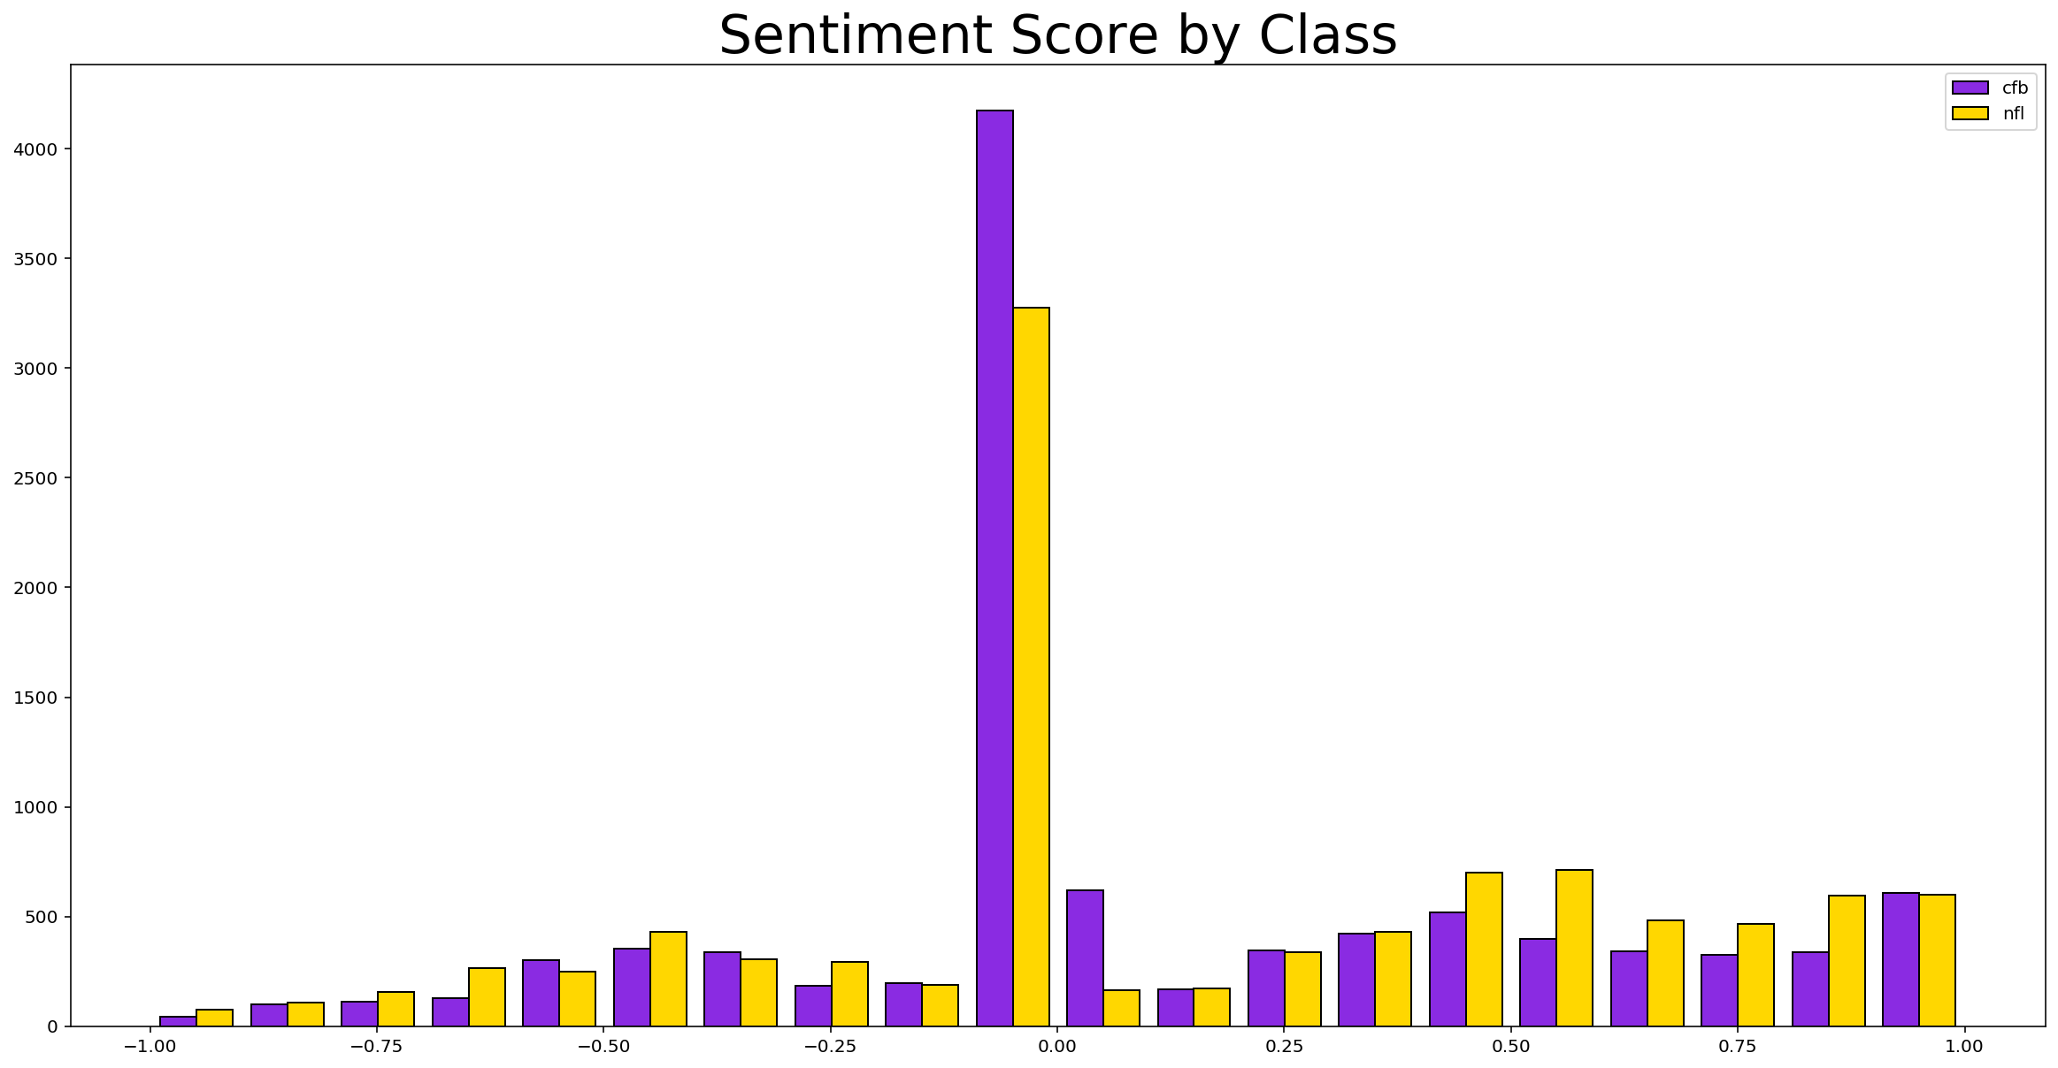
HAPPIER AUDIENCE

Slide 6
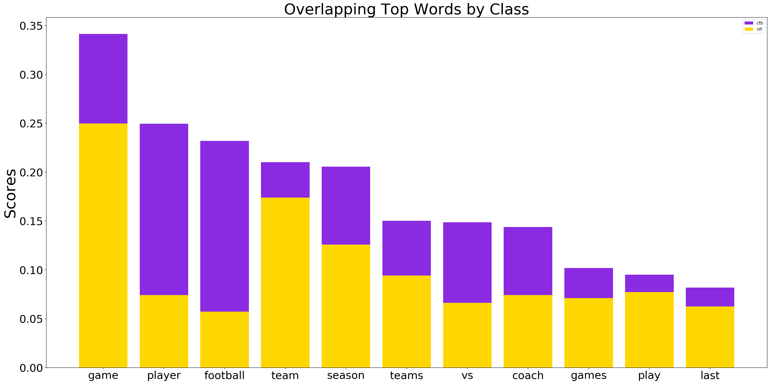
VARIED AUDIENCE

Slide 7
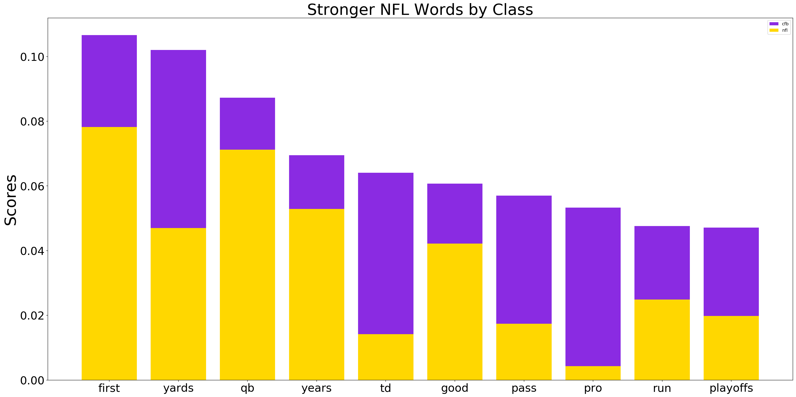
RESULTS BASED AUDIENCE

